Slide 1


Introduction to FXI
October 14, 2014
Presenters name, Title - Date

Slide 2
Goal of This Training
After this training, you should have the basic understanding of what FXI is used for.
You should have knowledge to write custom solutions using FXI.
You should have knowledge to trouble-shoot defects of custom solutions.
You should learn the good practices that TriZetto has built over years.

Slide 3
Subjects to Cover
FXI Categories
Database Level Integration
Batch Customization
Extensions
Letters
Integration Services Libraries
Interactive Driver/Interactive Listener
Media Integrator
FXI Adapters

Slide 4
FXI Overview
October 14, 2014

Slide 5
Introduction
What is Facets eXtended Integration (FXI)?
A solution to enable customers to integrate Facets with third party applications, or web portals.
Why FXI?
Facets = CORE System, but…
A Payor has auxiliary systems and supporting systems.
A Payor exchanges data with other entities.
A Payor wants to reduce the cost of ownership.
A Payor plans for upgrades and changes
FXI offers options of interfacing other systems with Facets.

Slide 6








Why FXI?

Slide 7

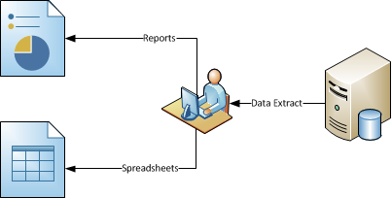
Why FXI?
Facets users may enter records manually!
Users may extract the data manually!

Slide 8
Why FXI?
Problems?
Too Time Consuming
One person can enter only so much data.
Too Costly
A Payor would need to staff enough to handle all incoming and outgoing data.
All resources must be highly skilled and trained.
No Traceability
If a discrepancy is reported, it is not possible to trace the root cause of the discrepancy.
Solution?? FXI!
FXI offers options of interfacing other systems with Facets.

Slide 9
FXI Categories
FXI Core
Exists as part of the Facets base system.
Provides customers with basic integration and customization capabilities.
FXI Foundation
A premium feature-set that enables customers access to key business logic.
Provides solutions to the more complex integration challenges.
FXI Adapters
Provides pre-built interfaces that enable integration between Facets and specific third-party applications.

Slide 10

FXI Core
FXI Core
Extensions
UI Customization
Search Customization
FXI Core
Related Information Area
Bulk Data Load Processes
Attachments
Provides customers with basic integration and customization capabilities.
Letters Subsystem
Batch Customization
DB Level Integration

Slide 11
FXI Foundation
FXI Foundation
Integration Services Library
Interactive Driver
Interactive Listener
FXI Core
Interactive Embedded Extension
Media Integrator
FXI Foundation
Data Publication Manager
Provides solutions to the more complex integration challenges.

Slide 12
FXI Adapters
FXI Adapters
GeoAccess
CDH
Adapters
ITS
FXI Core
HSS
Milliman Care Guidelines
FXI Foundation
ClaimCheck
Provides pre-built interfaces that enable integration between Facets and specific third-party applications.
iCES
Infocrossing
ClaimsXTen

Slide 13
FXI Core
October 14, 2014

Slide 14
FXI Core
Exists as part of the Facets base system.
Provides customers with basic integration and customization capabilities.
The most utilized FXI category!!

Slide 15
What you will learn
Database Level Integration
Batch Customization
Extensions
Letters

Slide 16
FXI Foundation
October 14, 2014

Slide 17
FXI Foundation
A premium feature-set that enables customers access to key business logic.
Provides solutions to the more complex integration challenges.
More Inquiries! More Requests!!
Real-Time integration with other systems
COM Services/Web Services
Interactive Driver/Listeners
Seamless integration of extensions and existing Facets applications
Imaging solution using Media Integrator

Slide 18
What you will learn
Integration Services Libraries (ISL)
Interactive Driver/Interactive Listener
Embedded Extensions
Media Integrator

Slide 19
FXI Adapters
October 14, 2014

Slide 20
FXI Adapters
Provides pre-built interfaces that enable integration between Facets and specific third-party applications.
Certain third-party applications are complement to Facets.
Adapters provide the customers ability to interact with Facets in real-time or batch transactions.
Maintained by the Product Team
Implementation of Adapters
License & Configuration
License is required for each adapter.
FXI Core is Required, but not FXI Foundation
Typically, no custom coding is necessary.
But, technical resources may need to assist Facets Product consultants.

Slide 21
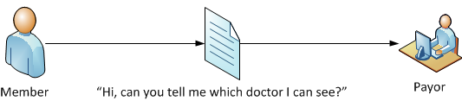
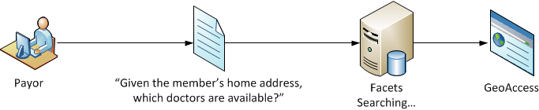
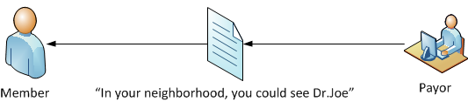
GeoAccess
Distance Based Geographical Searches for Providers

Slide 22
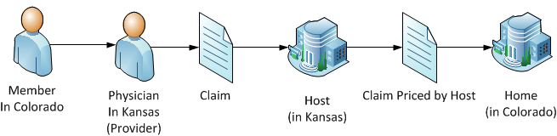
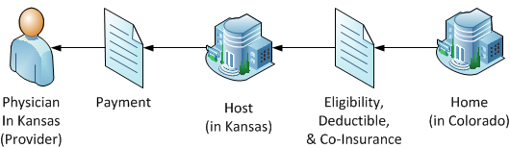
ITS
Blue Cross Blue Shield plans to share data between Facets and Inter-Plan Teleprocessing Services (ITS) software
ITS allows members to receive the same benefits of their contracting BCBSA plan.
ITS also links participating providers and the independent BCBSA plans across the country.

Slide 23
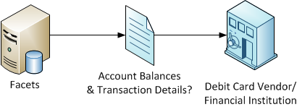
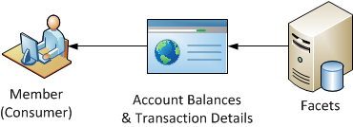
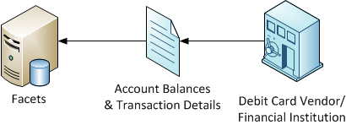
CDH
Offered as part of the Facets CDH Suite to provide integration between Facets and debit card vendors or financial institutions.
Managing Flexible Spending Accounts (FSA), Health Savings Accounts (HSA) and Health Reimbursement Accounts (HRA)

Slide 24
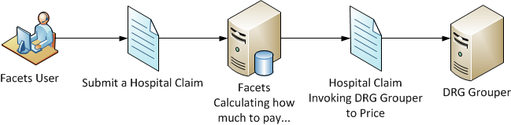
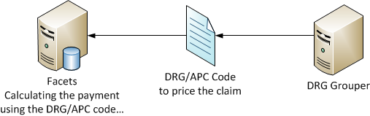
HSS
The interface to the HSS DRG Grouper during claims adjudication processes
Allows Facets to access the DRG (Diagnosis Related Group) grouper code and the APC (Ambulatory Procedure Code) code and price.

Slide 25
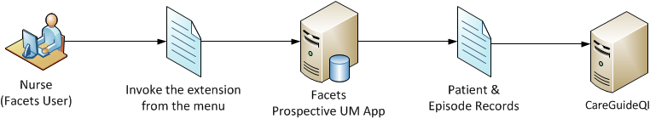
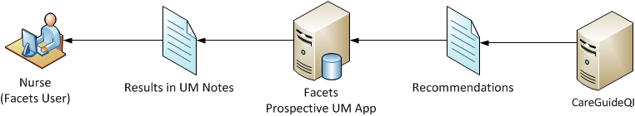
Milliman Care Guidelines
Allows nurse reviewers to access data regarding inpatient and surgical care, review criteria, and return the results to the Facets Utilization Management application.

Slide 26
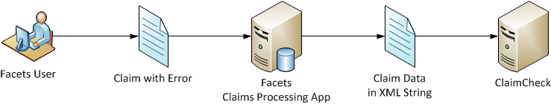
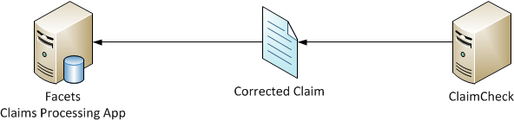
ClaimCheck
A claim-auditing tool from McKessen, Inc. that can programmatically correct claims that are submitted with inappropriate code combinations.

Slide 27
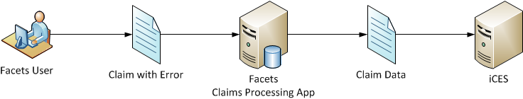
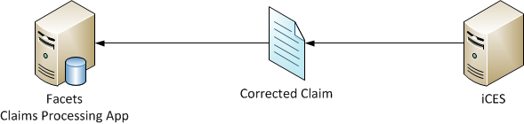
iCES
A claims editing system that automatically compares each claim with thousands of government, industry and corporate rules, regulations and policies, as well as customized rule logic that reflects individual company policy.

Slide 28
Infocrossing
Sharing information between Facets and Infocrossing Healthcare Service, Inc. (IHS) products.
Medicare eligibility verification
Member enrollment and disenrollment capabilities
Comprehensive reconciliation solution
Collection of Facets Batch Jobs
The Infocrossing/CMS Medicare Batch Export (ErCcsRunImbe)
The Infocrossing Medicare Reconciliation (ErCcsRunRecn)
The Infocrossing Medicare Reconciliation Cleanup (ErCcsRunRcnd)

Slide 29
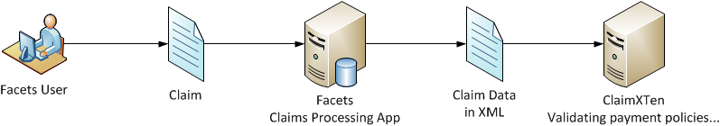
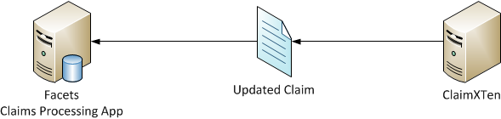
ClaimsXTen
Provides for the integration of ClaimsXten, a full-service claim editing/auditing solution from McKesson Inc., with Facets claim processing functionality.
ClaimsXten uses specific criteria to foster decisions that ensure payment policies are aligned with product design, provider contracting and medical policies.

Slide 30
Q & A
October 14, 2014

